Slide 1
Municipal Management Districts

Slide 2
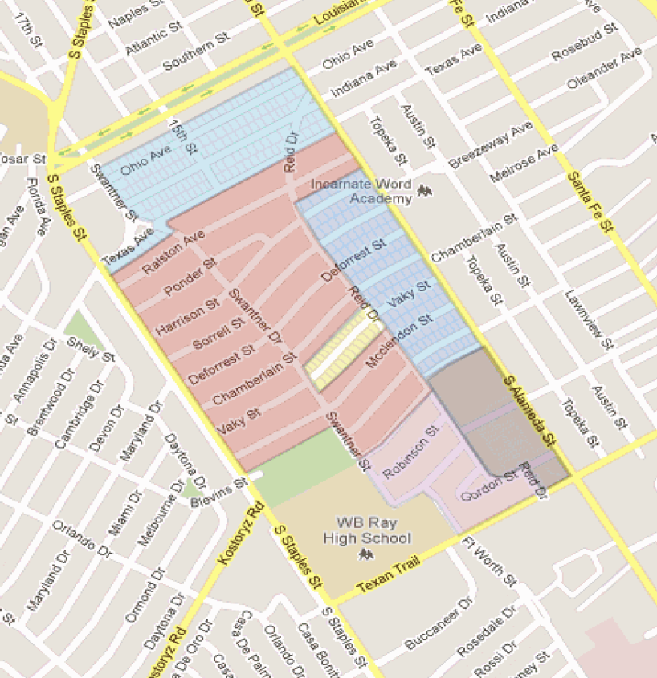

Slide 3
Overview
Municipal Management Districts (MMD) are special districts that are:
Self governed, but must be approved by the host municipality; and have the ability to construct public infrastructure and provide services within District approved service plan.
Created either:
Pursuant to Ch.375, Local Government Code, through the Texas Commission on Environmental Quality (TECQ,) or by local law enacted by the State Legislature.

Slide 4
Overview, cont’d.
• MMDs may issue Tax Exempt Bonds BUT bond debt is not city debt
and does not impact city bonding capacity.
– May levy taxes, assessments and impact fees in accordance
with service plan. Assessments only by petition of affected property
owners and property taxes require approval by majority of eligible
voters in district.
– Bond issuances must be approved by City Council.
• Often combined with TIFs to provide funding necessary to finance
infrastructure improvements and supplement city’s capital
investments
• There is significant use of this tool in other areas of the State
– Operated in Houston since mid-1990s.
– Several other Texas cities have established MMDs

Slide 5
What is the purpose of a Municipal
Management District?
• Promote, develop, encourage and maintain
employment, commerce, transportation,
housing, tourism, recreation, arts, economic
development, safety and public welfare
within a defined area.
• Provide and enhance supplemental services
to the area.
• Create an independent financing mechanism to
finance these services.
• Focused primarily on commercial development or
business activity.

Slide 6
How are MMDs Created?
• MMDs can be created in two ways:
– Through formal application to Texas Commission on Environmental Quality (TECQ) in accordance with the provisions of Chapter 375, Local Government Code
    • involves nine months process
    • serves primarily commercial development
    • requires a petition signed by owners of a majority of the
    assessed real property in proposed district
– Through a special local bill in the State Legislature
    • must be supported by local municipality and House/Senate
    authors and sponsors (four months)

Slide 7
What are MMD Powers and Duties?
• Are Self-governed and a political sub-division of the State,
but City has ability to require checks and balances in
formatting State legislation.
• Provides complimentary and supplemental services, but
does not replace services provided by municipality
• May levy taxes, assessments or impact fees in accordance
with its approved service plan. Assessments must be
requested by petition of affected property owners. Real
Property Taxes must be approved by a majority of eligible
voters in District.

Slide 8
How is MMD Governed?
• Generally track Chapter 375 of Local Government Code.
  – Initial board appointed by creating legislation/application.
  – New appointment/reappointments recommended by governing
board and approved by City Council.
  – Four year staggered terms
  – Board eligibility:
    • At least 18 years old
    • Resident or owner of property in the District
    • Owner of stock of a corporate owner of property in District
    • Owner of a beneficial interest in Trust that owns property in District
    • An agent, employee or tenant of a person that owns property in the
    District

Slide 9
What are Permitted Services and Projects?
• Economic Development
• Business Recruitment
• Promotion of Health and Sanitation
• Public Safety, Traffic Control and Recreation
• Landscaping, Lighting and Signs
• Streets, Walkways and Drainage
• Solid Waste, Water, Sewer and Power Facilities
• Parks, Historic Areas, Works of Art
• Parking Facilities and Transit Stations

Slide 10
How Does the MMD Generate Revenue?
• May issue bonds allowed by statute and its local governing municipality
• Bond debt is not City debt and does not impact City bonding capacity
• Bond debt supported by Real Property Taxes, Assessments or Impact
Fees (Assessments must be requested by petition of affected property
owners.) Real Property taxes must be approved by a majority of eligible
voters in District
• Under Chapter 375, District may not finance services and improvement
projects unless petitioner requesting those services and improvement
projects submitted by either owners of 50 percent or more of assessed
value in district or owners of 50 percent or more of surface area of
district, excluding publicly owned lands and lands exempt from
assessment.

Slide 11
Dissolution
• MMD exists until dissolved by:
– Petition by property owners (75%), or
– Vote of board
Additionally the MMD may be dissolved by
– Resolution of City Council

Slide 12
Use | Land | Improvement | Total | Taxable
Single Family | $ 13,976,565 | $ 64,048,154 | $ 78,024,719 | $ 61,395,359
Multi Family | 2,059,859 | 9,523,908 | 11,583,767 | 11,141,349
Office | 1,132,054 | 4,727,586 | 5,859,640 | 4,955,184
Commercial | 2,622,381 | 6,089,685 | 8,712,066 | 8,712,066
Total | $ 19,790,859 | $ 84,389,333 | $ 104,180,192 | $ 86,203,958

Slide 13
Cost to Property Owners
865 residential parcels of property are in the boundaries of the potential Municipal Management District for a total appraised value of $89,608,486
Based on total appraised value in 2012, the average value per residential parcel is $103,593
40 Commercial parcels of property are within the boundaries of the potential Municipal; Management District for a total appraised value of $14,571,706
Based on the total appraised value in 2012, the average value of commercial parcels is $2,604,048

Slide 14
On the average residential parcel, every $.01 of tax assessed would create a tax liability to the owner of $10.53
On the average commercial property, every $.01 of tax assessed would create a liability to the owner of $260.05
Each $.07 of tax assessed on the entire residential district would pay for approximately $1.0 million in capital project cost

Slide 15
Full Reconstruction
  Roadway Reconstruction $9,000,000
  Storm Water Costs $4,600,000
  Water Costs $1,150,000
  Wastewater Costs $ 900,000
    Total $15,740,000
      $1.1018 tax rate required = $1,141per year (residential)
      $1.1018 tax rate required = $28,691.40 per year (commercial)

Slide 16
Partial Reconstruction
  Roadway Reconstruction $6,300,000
  Storm Water Costs $4,600,000
  Water Costs $1,150,000
  Wastewater Costs $990,000
    Total $13,040,000
      Mill off asphalt and partial repair of roadway base
      $.9128 tax rate required = $945.59 per year (residential)
      $.9128 tax rate required = $23,769.75 per year (commercial)

Slide 17
Role of the City of Corpus Christi
Proposed role of the City of Corpus Christi is:
  Facilitator
  Technical Advisor
  Evaluator

Slide 18
Other factors
Tax Increment Refinancing Zone
Tax Increment Financing, or TIF, is a public financing method that is used for subsidizing redevelopment, infrastructure, and other community-improvement projects in many countries, including the United States. Similar or related value capture strategies are used around the world.
  If the cost of basic services increases, with TIF in place, the result is a revenue shortfall that has to be paid from sources other than tax revenues of the TIF district.
TIF is a method to use future gains in taxes to subsidize current improvements, which are projected to create the conditions for said gains. The completion of a public project often results in an increase in the value of surrounding real estate, which generates additional tax revenue. Sales-tax revenue may also increase, and jobs may be added, although these factors and their multipliers usually do not influence the structure of TIF.

Slide 19
Other Factors Continued
Tax Abatement
The Property Redevelopment and Tax Abatement Act, Chapter 312 of the Texas Tax Code, authorizes counties, cities and school districts to provide property tax abatement for limited periods of time as an inducement for the development or redevelopment of a property.

Slide 20
Next Steps
Clear identification of district boundaries
Project consideration/selection
More substantial modeling of cost to home owners
Identification of home owner interest
Briefing to City Council
Consideration of Preliminary Board Composition
Consideration of a Municipal Management District Service Plan
Seek approval through petition to Texas Commission on Environmental Quality (Majority of the assessed value of real property in the district, or 50 persons who own real property in the proposed district)

Slide 21
Questions?

